Slide 1
Levers

Slide 2
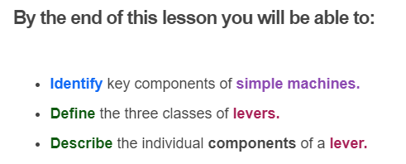
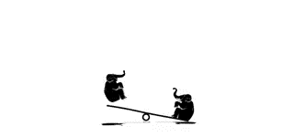

Slide 3
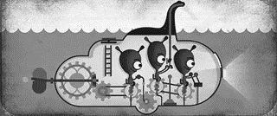
Machines are helpful because they make it easier for us to do a task.
Machines use the relationship between force and distance to do this. The simple machines include levers, inclined planes, wheels, pulleys and gears. These simple machines can be combined to make all other machines!

Slide 4
Simple machines make our lives easier.
We use simple machines, such as levers and pulleys, all the time in our daily life! They use fundamental physics concepts to operate.

Slide 5
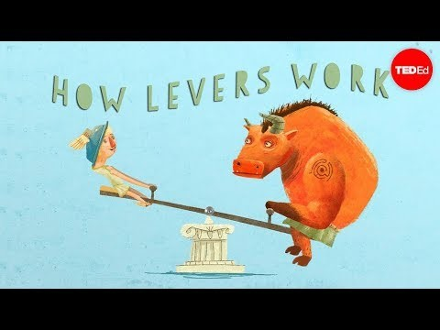

Slide 6
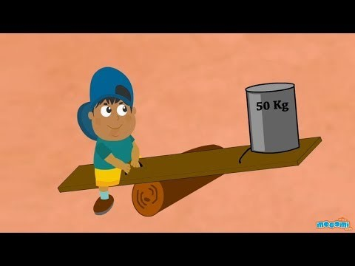

Slide 7
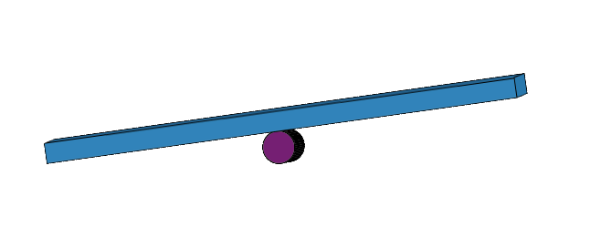
If you want to shift a heavy load, you could use a lever.
A lever is a plank or bar that rotates around a pivot or fulcrum that cannot move. It looks like this:

Slide 8
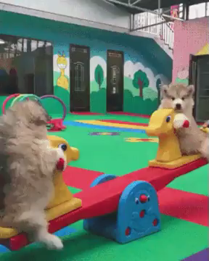
The load will be at one end of the plank, and force or effort will be applied to the other end to lift the load.
A seesaw is an example of a lever.

Slide 9
Simple levers reduce the amount of work.
In physics we use the term work a little differently. It means the amount of force used to move an object a certain distance.
When we use a lever, the further away from the fulcrum the force is applied, the easier it is to lift the load.

Slide 10
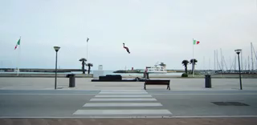
So far we have looked at the different components of levers.
There are also three different classes of lever that work in different ways.

Slide 11
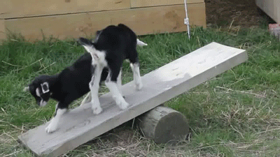
All levers have a pivot point, also called a fulcrum. This is the point the lever rotates around.
There are three different classes of levers. They are classified based on where the effort and load are in relation to the fulcrum. Let's have a look at each class in turn.
Effort is the force applied to the lever and load is the object we are trying to lift.

Slide 12
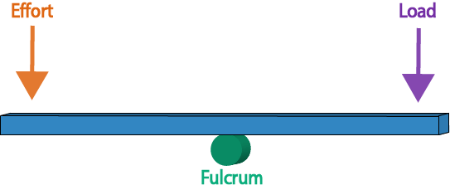
A first class lever has its fulcrum in between the load and where the effort is applied.
It looks like this:

Slide 13
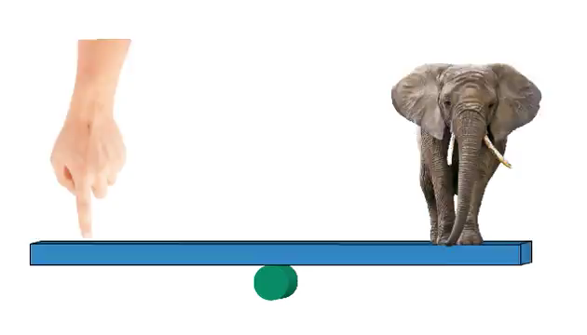
You can use a first class lever to lift a heavy object.
A seesaw is a great example of a first class lever.
The weight of the object pushing down is the load. You can lift it by pushing down on the other end, providing effort.

Slide 14
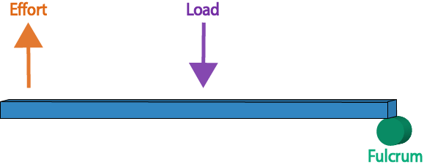
The second class lever has its fulcrum at one end of the beam.
Effort is applied to the other end, while the load is positioned between them.
It looks like this:

Slide 15
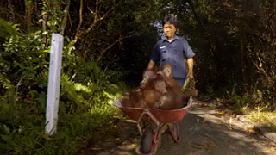
A wheelbarrow is an example of a second class lever.
It's wheel is the fulcrum and the load is everything inside the bucket part. You apply effort to the handles.

Slide 16
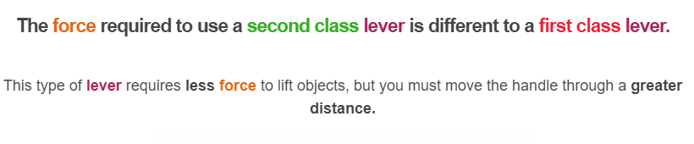
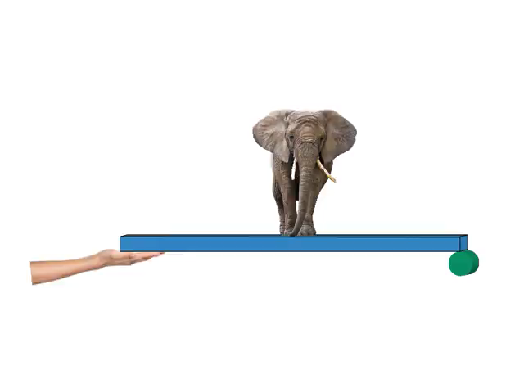

Slide 17
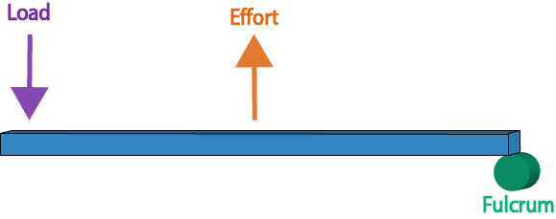
Third class levers have their fulcrum at one end of the beam.
The load is located at the other end, while you apply effort at a point between them.

Slide 18
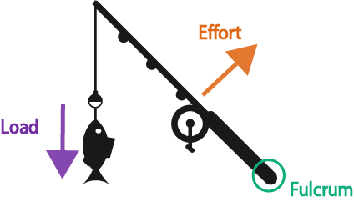
A fishing rod is a great example of a third class lever!
A fish caught on the end of the fishing rod acts as the load, and the base of the rod acts as the fulcrum. A person will apply effort in the middle of the rod to pull the fish in!

